Slide 1
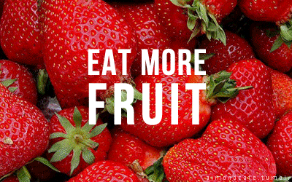
What are these?

Slide 2
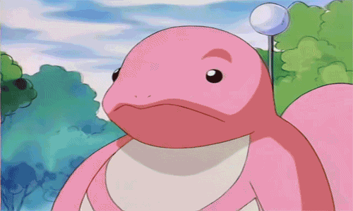
Let’s be Lickitung to read aloud!

Slide 3
What’s this?
It’s a/an ___.
What are these?
They’re ____s.

Slide 4
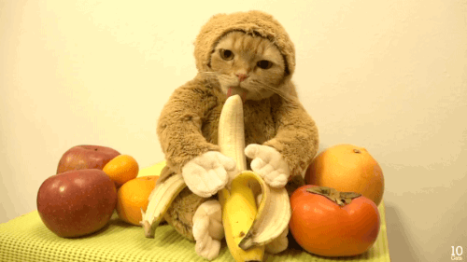
It is a banana.

Slide 5
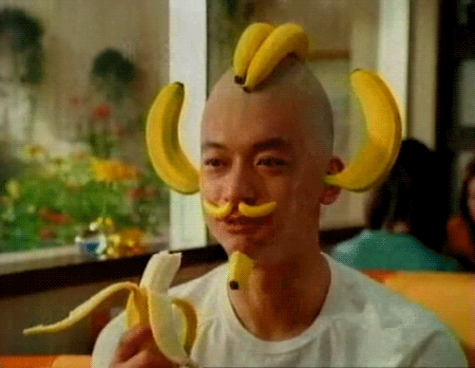
They are bananas.

Slide 6
It is an apple.

Slide 7
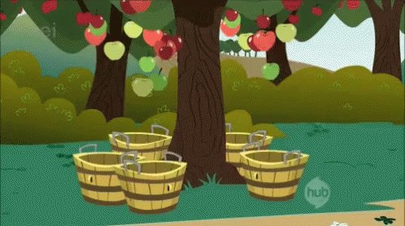
They are apples.

Slide 8
It is a watermelon.

Slide 9
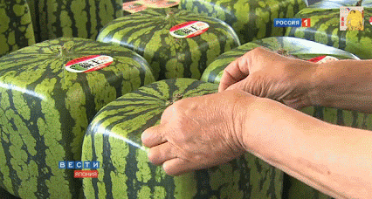
They are watermelons.

Slide 10
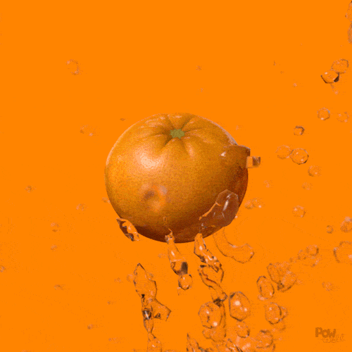
It is an orange.

Slide 11
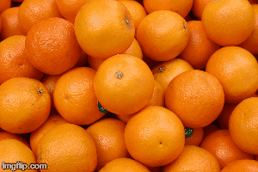
They are oranges.

Slide 12
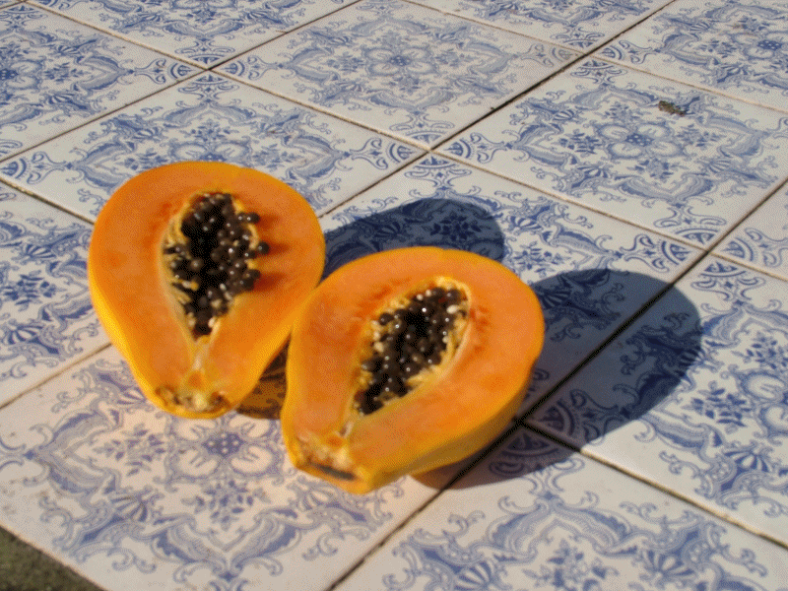
It is a papaya.

Slide 13
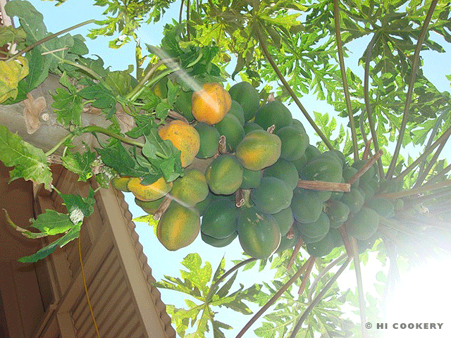
They are papayas.

Slide 14
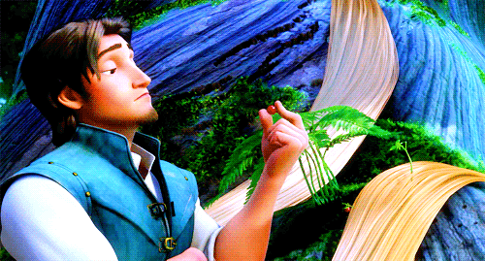
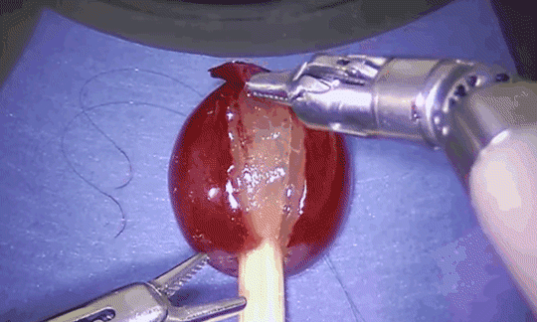
It is a grape.

Slide 15
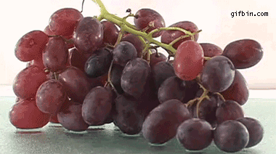
They are grapes.

Slide 16
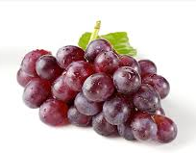
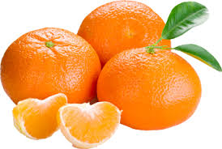
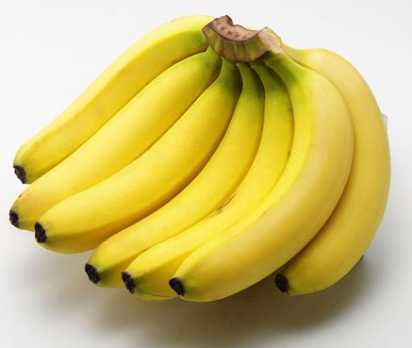
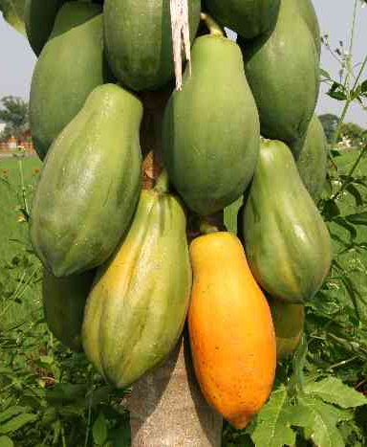
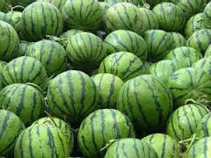
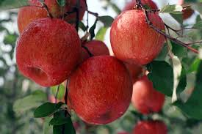
grapes
oranges
bananas
apples
papayas
watermelons

Slide 17
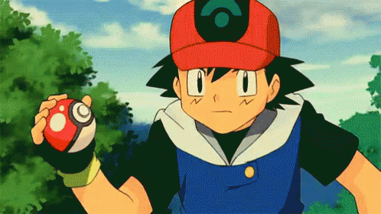
Good job!
Let’s turn to page 39 and listen to the story.

Slide 18
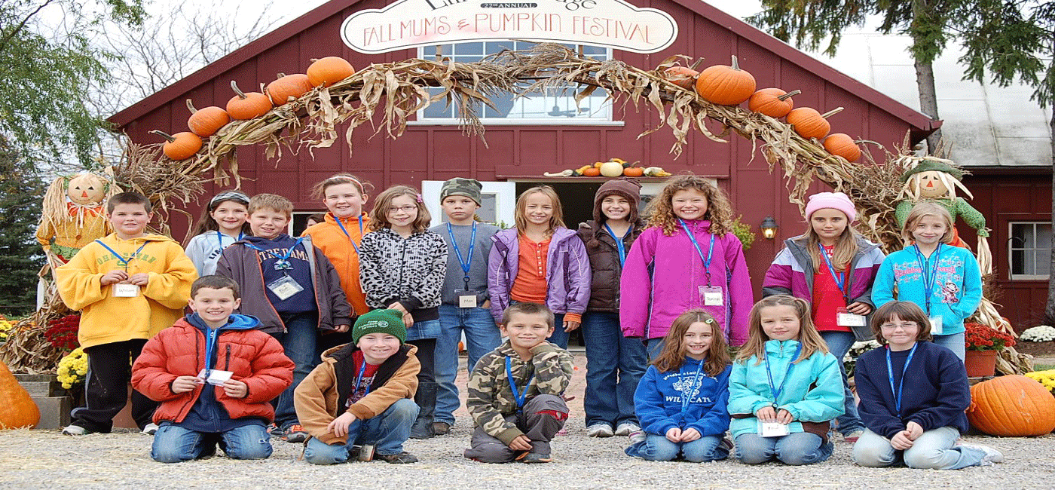
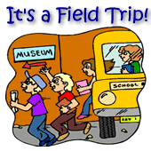
field trip校外教學

Slide 19
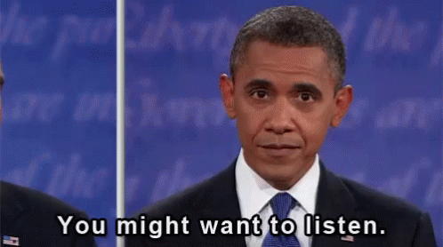
Story Time

Slide 20
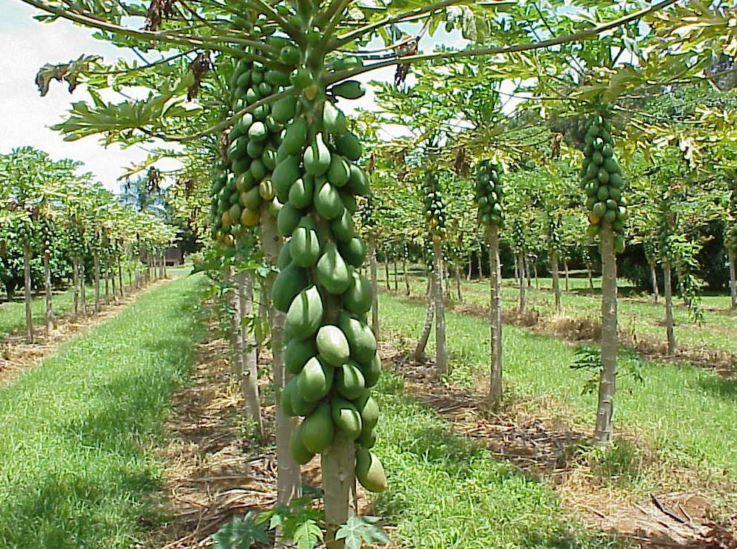
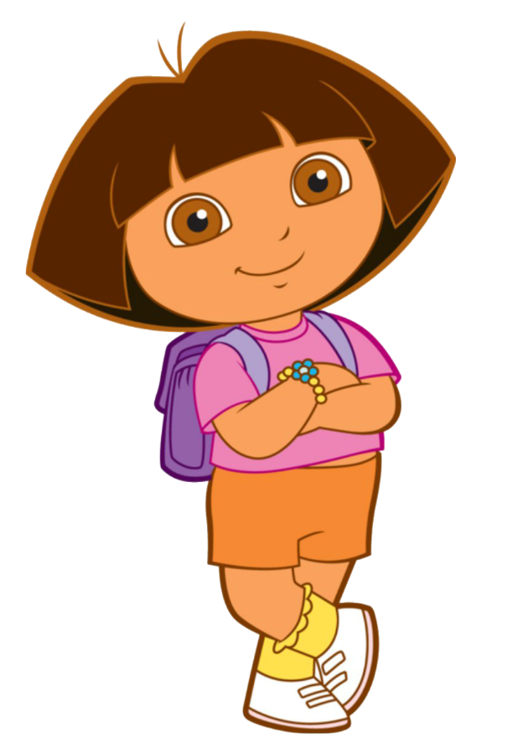
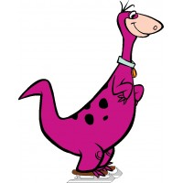
Wow!
What are these?
They’re papayas.

Slide 21
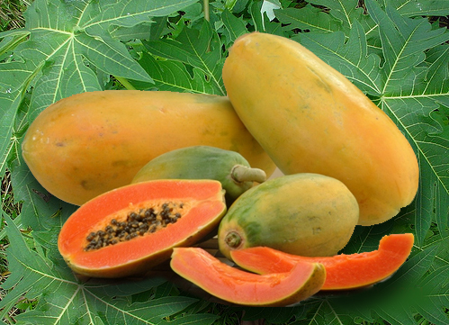
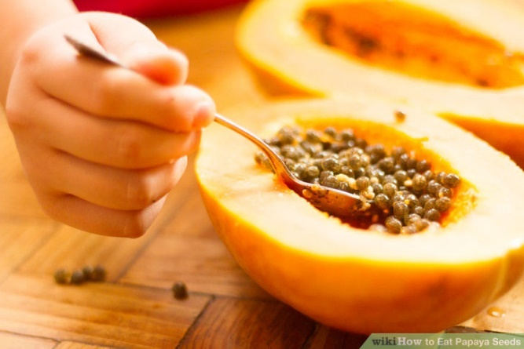
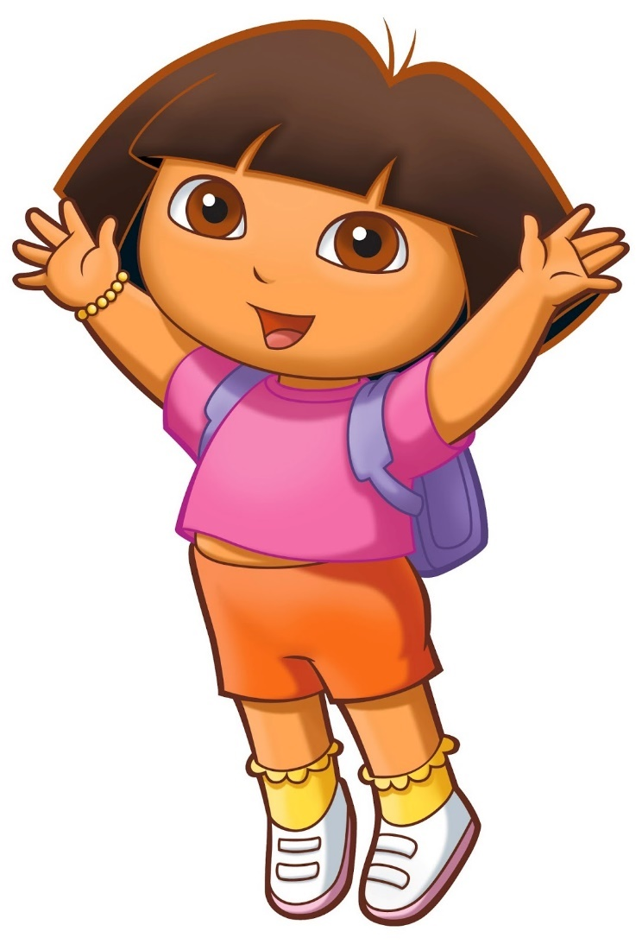
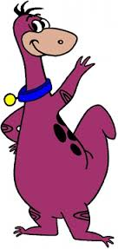
Yes, I do.
Do you like papayas?

Slide 22
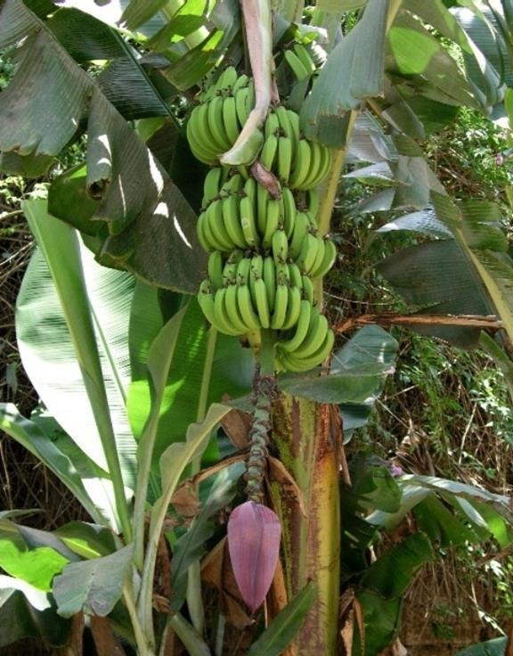
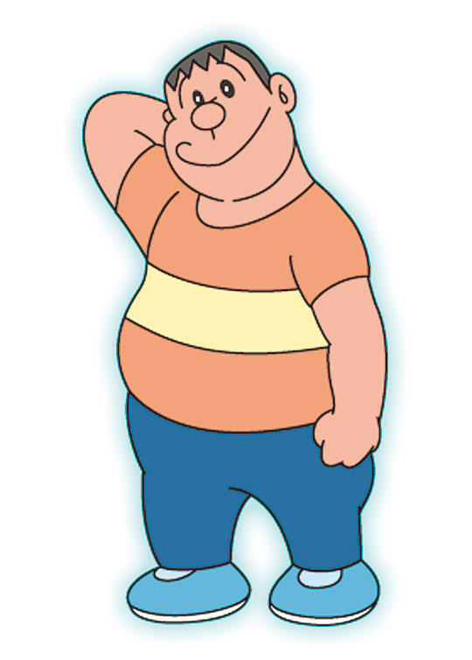
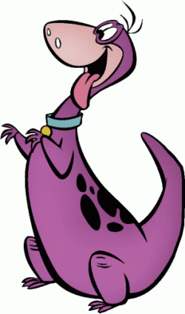
What are these?
They’re bananas.

Slide 23
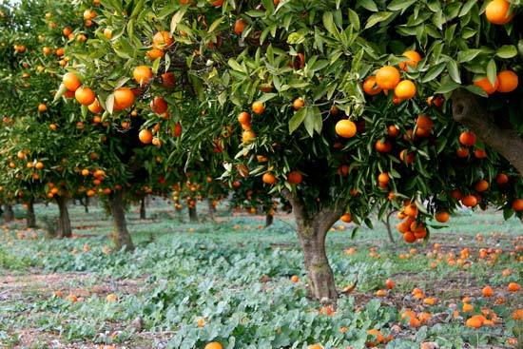
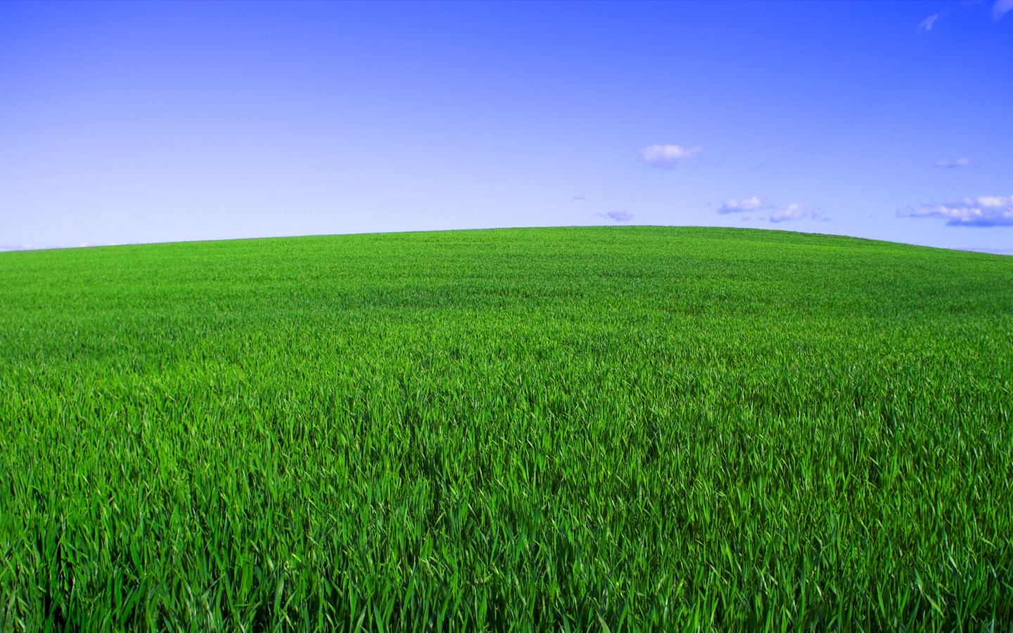
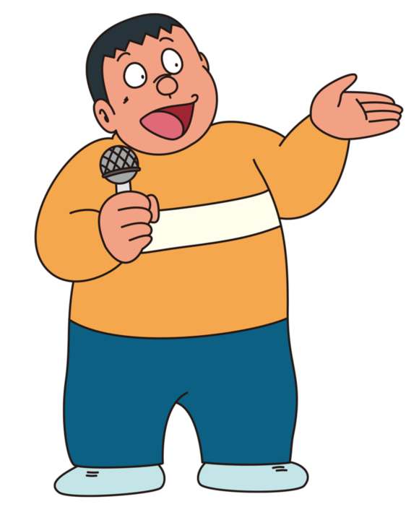
What are those?
They’re oranges.

Slide 24
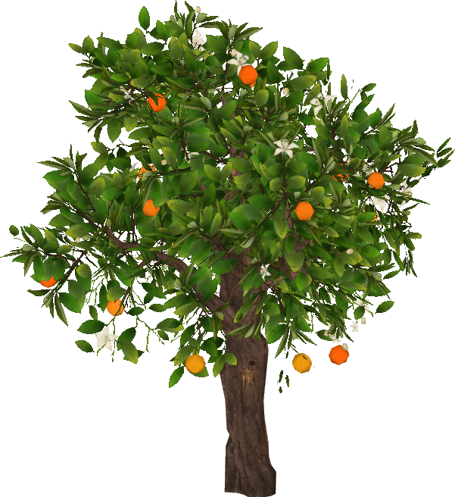
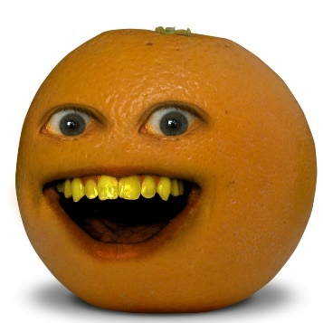
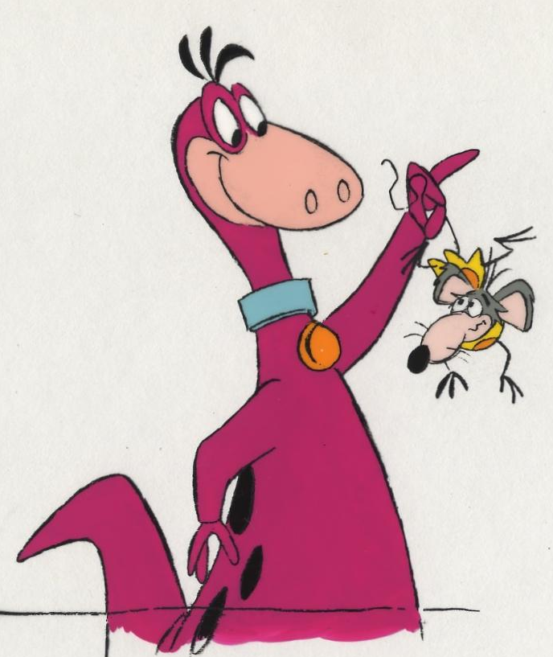
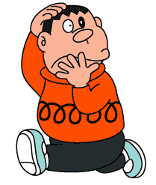
No,I don’t.
Do you like oranges?

Slide 25
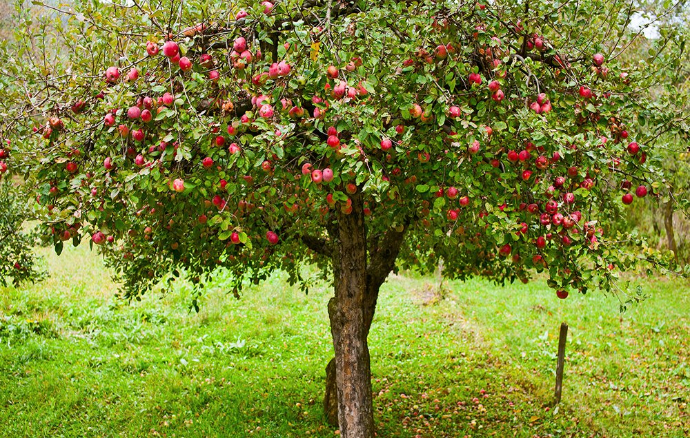
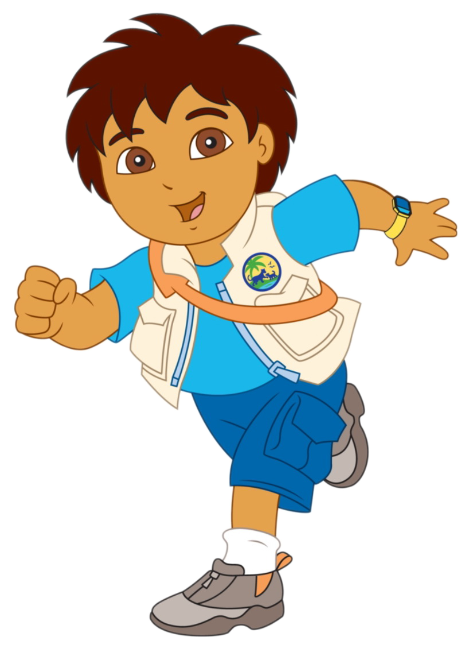
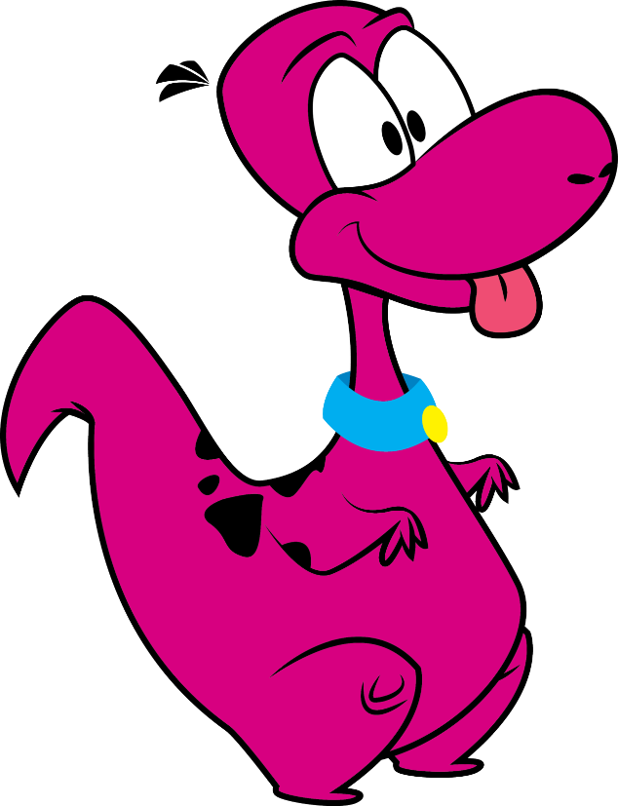
Look,Dino!
Apples.
Great! I like apples.

Slide 26
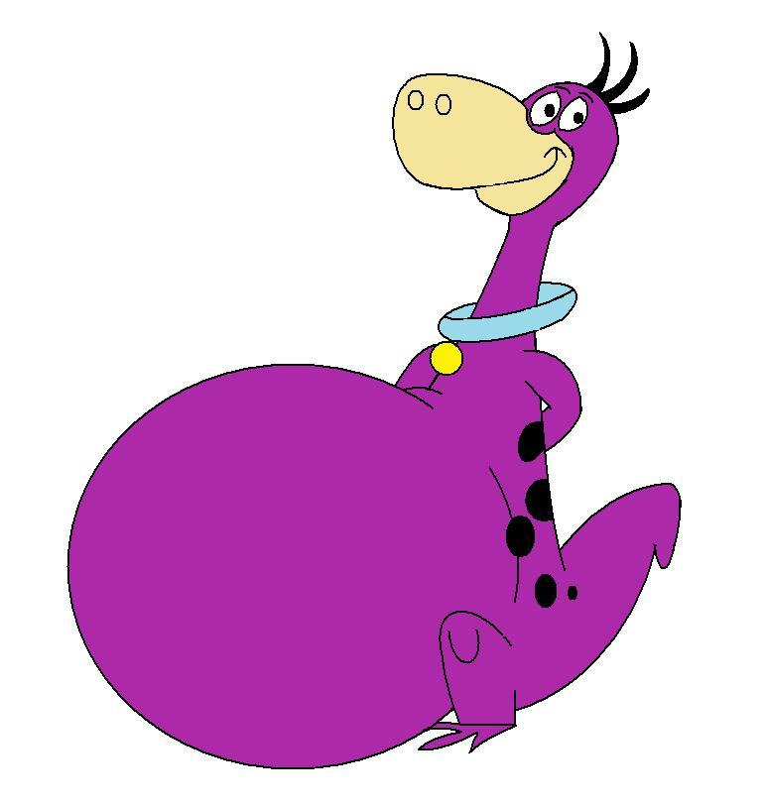
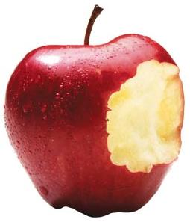
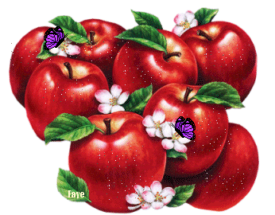
Yummy!

Slide 27
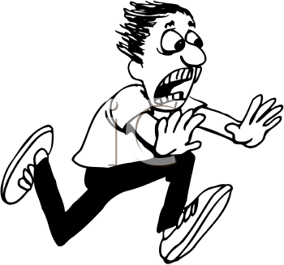
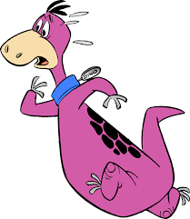
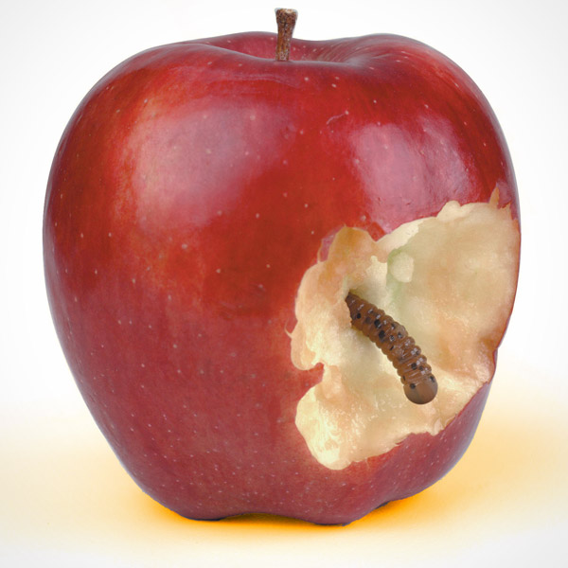
Yuck! I don’t like worms.
Hello!

Slide 29
Wow!
What are these?
They’re papayas.

Slide 30
Yes, I do.
Do you like papayas?

Slide 31
What are these?
They’re bananas.

Slide 32
What are those?
They’re oranges.

Slide 33
No,I don’t.
Do you like oranges?

Slide 34
Look,Dino!
Apples.
Great! I like apples.

Slide 35
Yummy!

Slide 36
Yuck! I don’t like worms.
Hello!

Slide 37
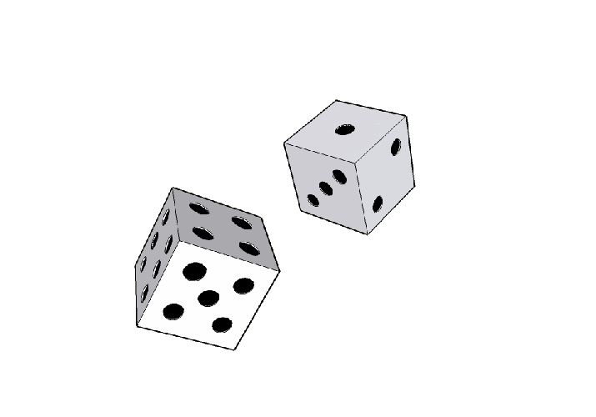
1 → Group 1/3/5 read
2 → Group 2/4 read
3 → Mute (lips read)
4 → Mandy reads (Find mistake)
5 → Free
6 →

Slide 38
這個
那個
this / that
these / those
這些
那些

Slide 40
This
This

Slide 41
_______ are apples.
These

Slide 42
_____ is a pineapple.
That

Slide 43
_____ are pens, pineapples and apples.
Those

